Slide 1
1.79 Database Release
November 23 updates to Cloud and Care Control applications
Notes:
We’re excited to share some significant updates that have been implemented to enhance our user experience across all our platforms.

Slide 2
Overview
Care Control
This release contains changes to Windows, Mobile, Pocket and eMAR. These are predominantly branding changes and bug fixes, but some new functionality has been added.
Cloud
In line with previous Cloud updates, this one contains a range of new features as well as amendments to existing areas of the system.

Slide 3
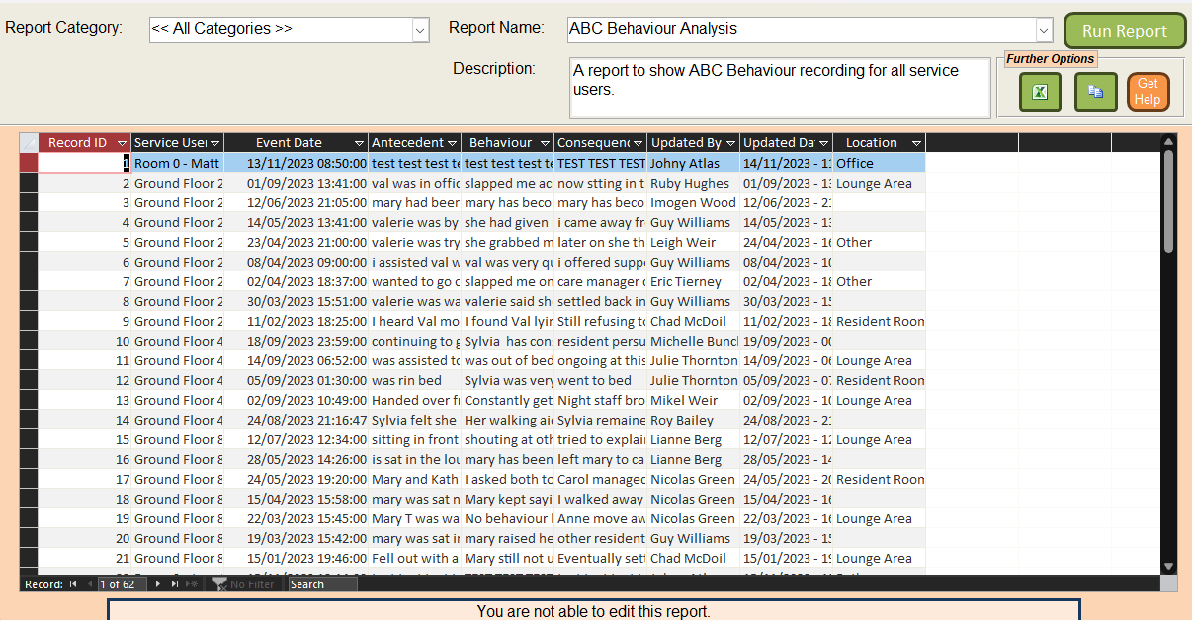
Care Control
New Features
(Wind.) Food Intake Analysis & ABC Behaviour Reports
(Wind.) 10 new Custom Fields
(Mob.) Maintenance Tool now available
(Mob.) Care Review Proposals now available
(eMar) Zero Stock Support added
(eMar) Additional Comments now available in Stock Adjustments.

Slide 4
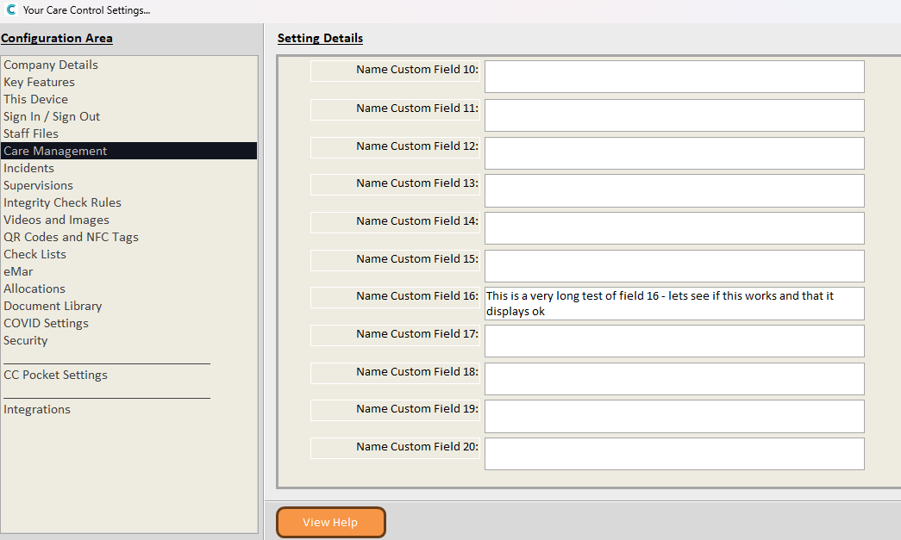
Care Control
New Features
(Wind.) Food Intake Analysis & ABC Behaviour Reports
(Wind.) 10 new Custom Fields
(Mob.) Maintenance Tool now available
(Mob.) Care Review Proposals now available
(eMar) Zero Stock Support added
(eMar) Additional Comments now available in Stock Adjustments.

Slide 5
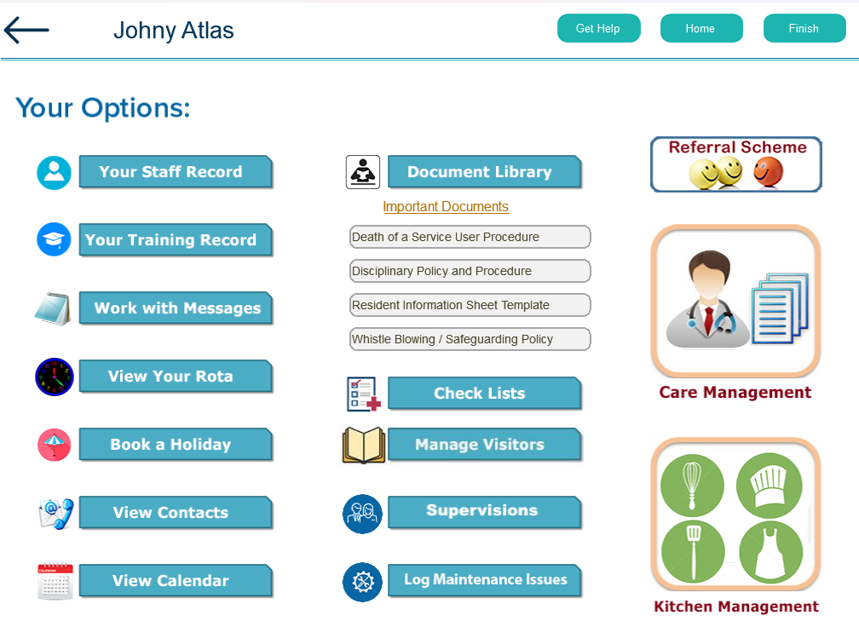
Care Control
New Features
(Wind.) Food Intake Analysis & ABC Behaviour Reports
(Wind.) 10 new Custom Fields
(Mob.) Maintenance Tool now available
(Mob.) Care Review Proposals now available
(eMar) Zero Stock Support added
(eMar) Additional Comments now available in Stock Adjustments.

Slide 6
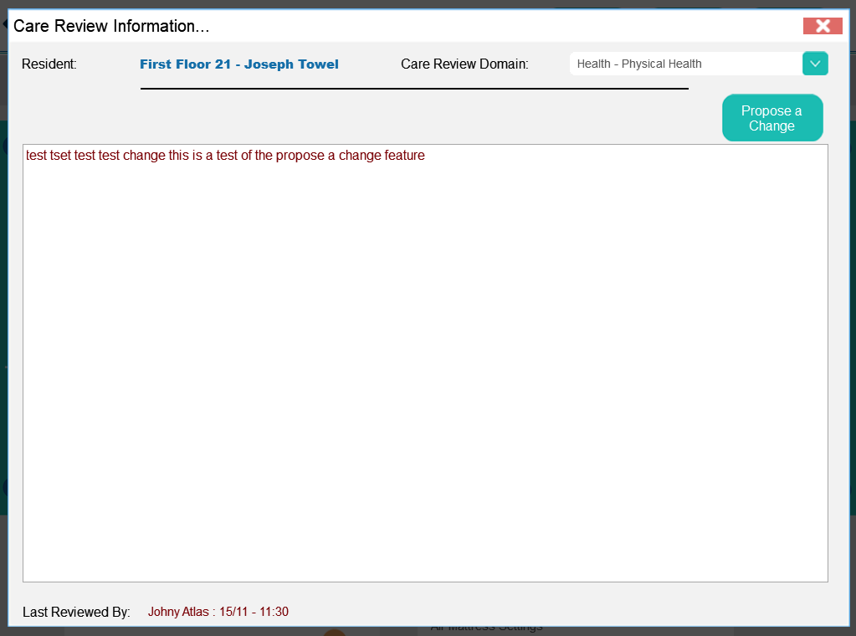
Care Control
New Features
(Wind.) Food Intake Analysis & ABC Behaviour Reports
(Wind.) 10 new Custom Fields
(Mob.) Maintenance Tool now available
(Mob.) Care Review Proposals now available
(eMar) Zero Stock Support added
(eMar) Additional Comments now available in Stock Adjustments.

Slide 7
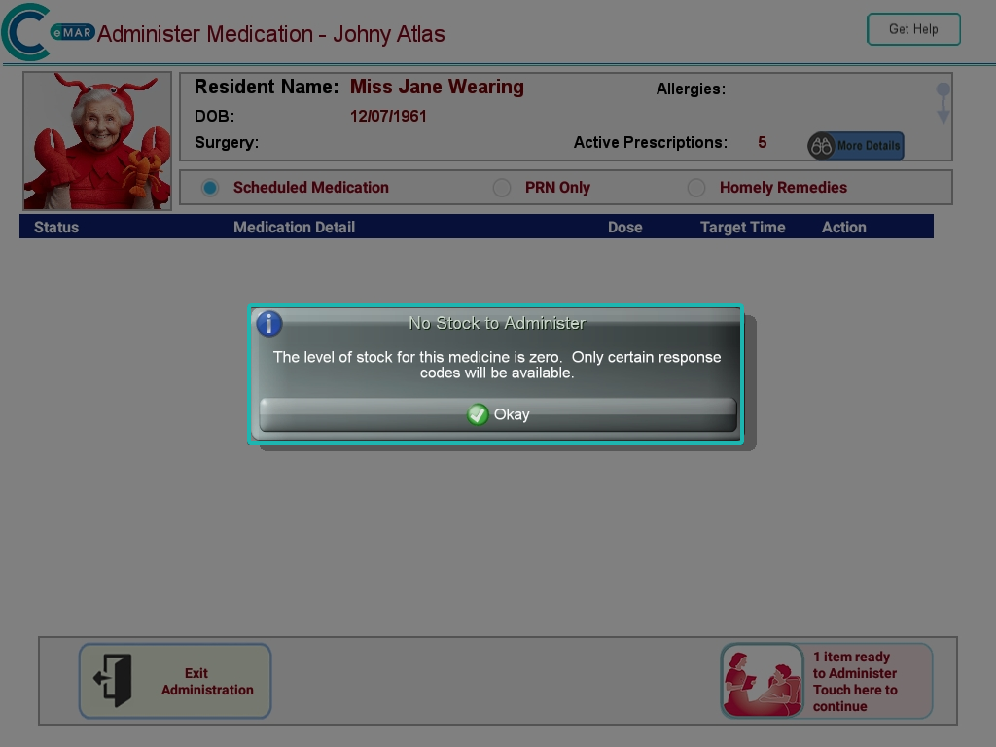
Care Control
New Features
(Wind.) Food Intake Analysis & ABC Behaviour Reports
(Wind.) 10 new Custom Fields
(Mob.) Maintenance Tool now available
(Mob.) Care Review Proposals now available
(eMar) Zero Stock Support added
(eMar) Additional Comments now available in Stock Adjustments.

Slide 8
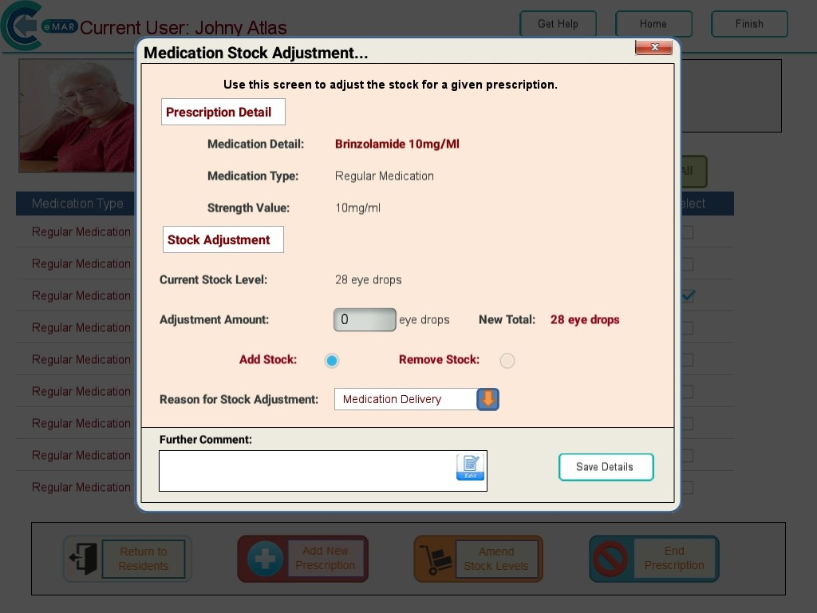
Care Control
New Features
(Wind.) Food Intake Analysis & ABC Behaviour Reports
(Wind.) 10 new Custom Fields
(Mob.) Maintenance Tool now available
(Mob.) Care Review Proposals now available
(eMar) Zero Stock Support added
(eMar) Additional Comments now available in Stock Adjustments.

Slide 9
Care Control
Branding Changes
New load and close animated screens
New iconography

Slide 10
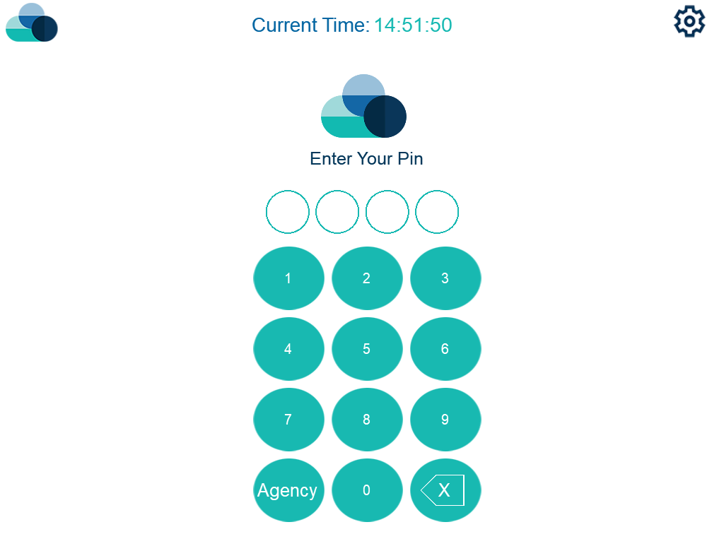
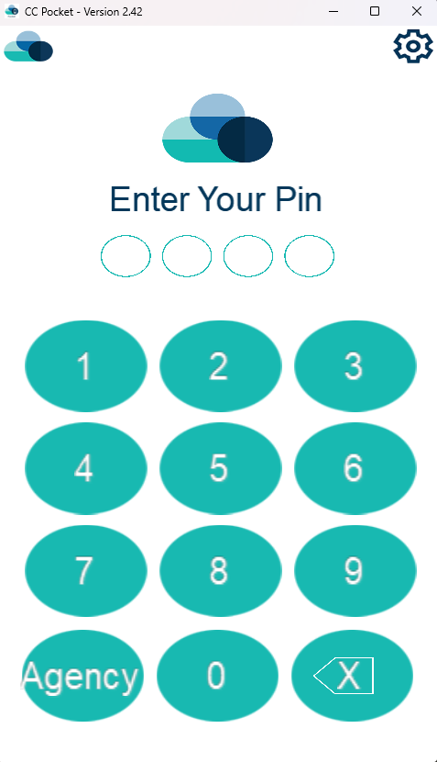
Care Control
Branding Changes
New load and close animated screens
New iconography

Slide 11
Care Control
16 Bug Fixes & Other Changes
(Wind.) 18+ Age Category for Risk Assessments
(Wind.) Org Management Fixes & Updates
(Wind.) Corrections – Removing Red Flags from notes
(Wind.) Corrections – Basic editing of Incidents
(Wind.) Corrections – Move note to other Staff Member
(Wind.) Closing Heath Issue removed Red Flag
(Wind.) Incident summary uses drop-down list
(Wind.) Incident summary – removed ‘Other’ option
(Pock./Mob.) Facial Recognition sign in/out fixed
(Pock./Mob.) Keyring Site Switch Support
(Mob.) Day Centre fixes
(Mob.) Agency sign in fixed
(Mob.) General Note recording fixed
(Mob.) Photo Upload tool fixed
(Mob.) Generic & Bed Rail RA’s fixed
(Mob) QR Codes for Intensive Care Monitoring fixed
Notes:
But that's not all—our team has been hard at work implementing a range of updates, performance improvements, and fixes across the board. These changes are geared towards providing a smoother and more efficient experience while using our platforms.

Slide 12
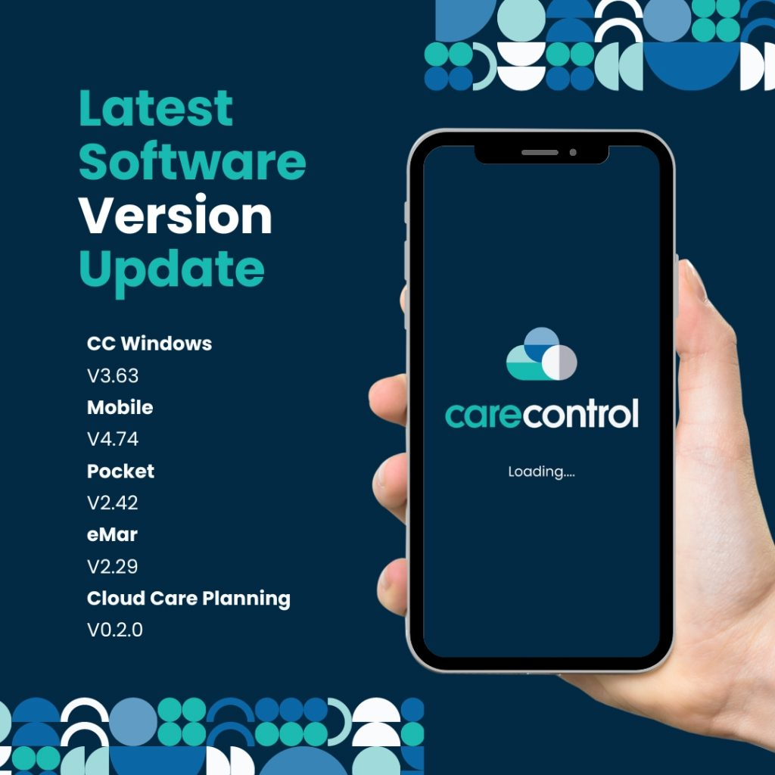
Care Control
Version Numbers
As of Weds 22nd November 2023

Slide 13
Cloud
New Features
Includes the first version of Single Custom Forms in Care Planning: accessible via Recording Areas and shown in Monitoring Analysis, Risk Assessments, and Incident Analysis. This version is a mirror of the functionality in CC Windows & CC Mobile, with support for new question types – Body Map, Photo & Document Upload, Complex & Multi Select Down, Grid Select, and Signature.
Includes the first version of Care Review Editing for Care Planning: allowing users to create new care reviews and finish incomplete ones.
Includes "My Hub" rebranding.
Includes the ability to record additional Risk Assessments: Bed Rail, Burns and scalds, Falls, General, Medication, Movement, PEEPs, and Generic.
Includes the ability to record Mental Capacity Assessments.

Slide 14
Cloud
Other Changes & Fixes
Adds the ability to delete permission role assignments in each app's permission settings.
Fixes an issue in all apps where a return URL was specified when the user logged out.
Fixes an issue where an invalid return URL was specified when the user's session timed out.
Adds support for saving files to remote shares (web to SQL box).
Includes deep link updates to Insights.

Slide 15
Thank you
support@carecontrolsystems.co.uk

